Slide 1

SAP Analytics cloud training
Anubhav Oberoy
Day 6

Slide 2
Agenda – Day 6
Introduction to Planning
- Planning Jargons
- Introduction to Planning models
Notes:
- What If Scenario
- Update scenario
- Distribution and Spreading
- Asymmetric Report
- Allocation
---Break---
Value Driver Tree
- VDT
- Type of VDT
- Create from Blank Model
- Design VDT
- Create New Model

Slide 3

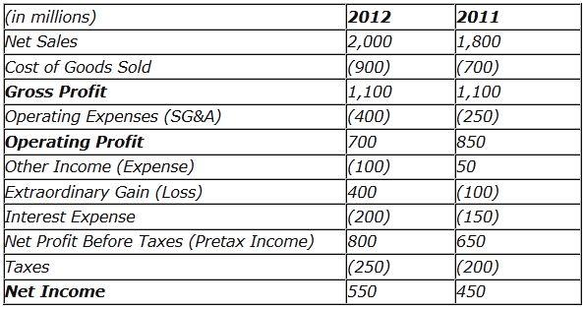
Planning Jargons
Revenue: Total amount of goods and services produced by an organization in a given span of time.
GDP – (Country)
Gross Revenue: total income earned by a co. in a specific period.
1000 X 100$ = 100,000$ - 5000$ = 95000$
Indicate the potential for the growth.
Revenue = Units X Price per unit
Net Revenue = Revenue – Returns – Discounts
Net revenue is indicative of quality
Gross Profit = Net Revenue – Cost of goods(raw, labor, machinery, packaging, shipping)
Gross Margin % = Gross Profit / Net revenue
Operating Profit % = Operating income / Net Revenue
Operating Expense Ratio (OER) = Operating Expense/ Net Revenue
www.anubhavtrainings.com

Slide 4
Planning Model – need to know
Planning data model includes versions (categories – Actuals, Forecast, Budget)
Actuals: Current facts data which is most recent or could be past experiences in reality. Transaction data.
Budget: Budgeting is the financial direction of where management wants min to be achieved, this is what will help qualifying the expectations of revenue that business expects. The budgeting number decides the bottom line of the company.
Forecast: tells whether the company is headed in right direction, estimating the amount of revenue and income that be achieved in future.
2. Planning models, will mandatorily have DATE/TIME Dimensions
3. We can also have organization dimension which represents the Business Entity (a plant, a subsidiary).
Regions → Country → States → Cities → Entity
www.anubhavtrainings.com

Slide 6
Planning model – Account Dimension
4. Account Dimension
In a planning model represents a business ledger account like operating expense, gross profit, net revenue. Most of these are calculated by other dimensions.
We will always can have a parent-child hierarchy in a/c dimension. This hierarchy is used to aggregate the numbers and calculate accounts based on hierarchy levels.
For each account dimensions we have contributions
EXP, INT – Expense – negative
INTINC, INC – Income -- positive
NFIN – Non Financials
5. We can apply currency conversion in finance data dependent on exchange rates
Average, Closing
www.anubhavtrainings.com

Slide 7
Create Planning Model – Hands on
Planning Model demo dataset <link>
1. Mark Properties and descriptions (later used for hierarchy creation)
2. Geo Enrich Data
3. Mark ENTITY, ACCOUNT, DATE and VERSION Dimensions
4. Data Wrangling
----Model created
1. Maintain model preference for FY, Data, Currency Conversion
----Model Hierarchies
1. Copy paste the account data properly
2. Create a story on planning model
www.anubhavtrainings.com

Slide 8
Demo Scenario
- Stefany Myer
<Click here>

Slide 9
Version Management
While working with finance/planning data, we don’t want to change the actual facts because we just want to play around with data and see if this data can be used for productive purpose later. As an SAC consultant, until you finalize all the changes, you want to work privately by changing data number of times.
So we always have possibility to create multiple versions of the data by copying existing version data.
SAC options → Version Management
And we will create a new version. This will be private (which means, other users in SAC tenant will not be able to see it, until we publish)
What If Analysis
Where the business will ask, what if questions e.g. what is the impact of change of one account on another. Like if we like to increase operating income by 10%, what will be the impact of the same on operating margin, expenses.
Direct Increase & Decrease | Variance Chart | Distribution & Spreading
www.anubhavtrainings.com

Slide 10
Planning continues…
Updates
When a particular a/c or Dimension data is not available in SAC, we want to introduce the same, we can also use the planning using updates scenario.
e.g. my co. wants to introduce a subsidiary in another country in a region, how much profit can I increase if I do so.
HANA Function Documentation
http://sap.optimieren.de/hana/hana/html/_gsql_functions.html
www.anubhavtrainings.com

Slide 11

What if Scenario
Where the business will expect what will happen in case a particular situation, goal or a deadline arrives. We would like to simulate, what if something happens. We will see now what if I want increase my forecast of operating income an increment of 30%, how much cap I will have to spend more, what will be expected gross sales.
After that we would like to also add a variance chart.
Version management – it is a inbuilt feature inside SAC planning, you see when we do planning we do not want to apply the changes on our data directly. We would like to avoid any side effect/contamination of our original model data. Here by SAP provides version management feature, where we can copy version of a data to new one, you can make all the changes you need to the new version and once everything is fine, you can publish the version to execute the plan.
www.anubhavtrainings.com

Slide 12
Distribution and Spreading
Distribution – simply taking some portion of a value from one dimension of a account and distribute the same to another dimension.
Spreading – dividing a account value between a dimension’s child equally or proportionately.
Locking a field – we can lock a particular cell in SAC table, after that if we apply any calculation that will be applied on all the child cells except the locked one.
Update scenario
Allows us to observe/simulate the impact of change/introduction of new dimension values on the business. For example, I introduce a new product called ball cap, what will be impact on my gross sales per quarter.
www.anubhavtrainings.com

Slide 13



Asymmetric Report
In general the values in the dashboard will be shown for all the dimensions across. If we want to target a specific value for a specific time frame for a specific requirement. We can create a asymmetric report.
My management asked to build a report which shows the Gross profit for Q2 2020 actual and compare that with gross profit Q2 2020 forecast.
www.anubhavtrainings.com

Slide 14


















Allocation
An allocation is a distribution but based on a condition. We perform allocation by spreading/distributing data across account dimensions in proportion to a condition is met.
www.anubhavtrainings.com

Slide 15
Objects of an Allocation
Allocation
Step
Rule
1 *
1 *
www.anubhavtrainings.com

Slide 16
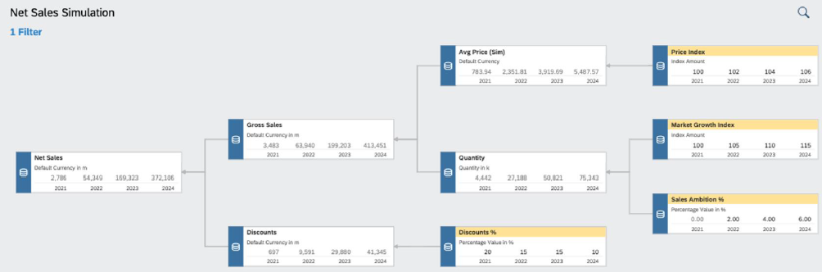
VDT
▪ Value driver trees (VDTs) allow visualizing the composition of a KPI and its contributing factors
▪ A VDT shows how a KPI is calculated from other KPIs and drivers
▪ In SAC, a value driver tree can be used to visualize existing data but also to simulate the impact of driver
changes in real time
▪ In planning, the VDT component can be used to create and simulate different scenarios
▪ Value driver trees are provided as standard story widgets and can be seamlessly integrated into SAC stories
www.anubhavtrainings.com

Slide 17
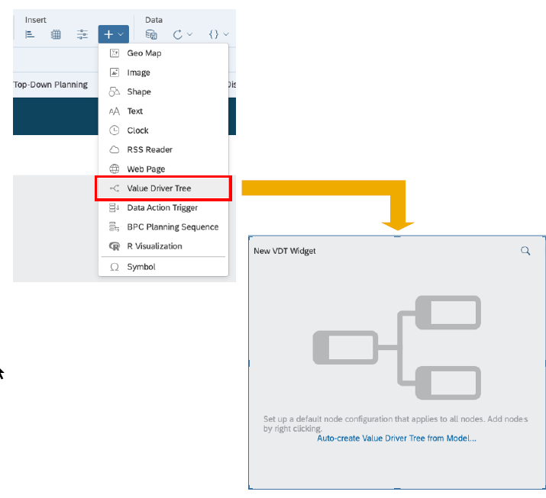
VDT
A value driver tree is a standard widget in the story
▪ VDT widgets can be configured like any other story widget by adding a new component and then using the builder panel
▪ A VDT is based on a data model. The nodes of the tree correspond to KPIs defined in the account dimension
▪ You can automatically generate a value driver tree from an existing model
▪ Alternatively, you can start building the tree from scratch, defining the nodes manually
www.anubhavtrainings.com

Slide 18
Use case 2
We would like observe the impact of market growth, price index, growth rate on our net revenue. VDT is just a representation of account dimensions connected together. All the calculations related to VDT are going to be done inside the MODEL.
Gross Sales = Quantity (~MarketGrowth, ~SalesAmbition) X Price (~PriceIndex)
Net Sales = gross Sales – Discount (~Discount %)
Price
Price Index
Gross Sales
Growth Rate
Quantity
Net Sales
Sales Ambition %
Discount
Discount %
www.anubhavtrainings.com

Slide 19
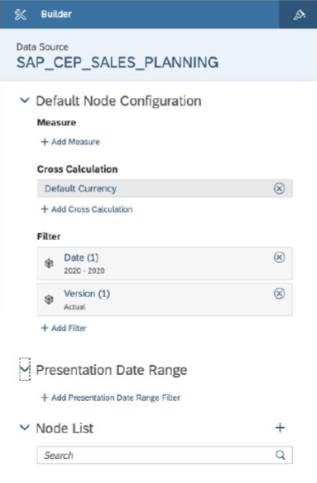
VDT – Node Config
A VDT is built by adding multiple nodes to the Node
List in the builder panel
▪ Each new node will inherit the default node configuration
▪ The configuration can be adjusted for each individual node
▪ The (visual) relation between the nodes is configured via parent/child properties of each node
▪ Parent/child nodes are other existing nodes from the node list
www.anubhavtrainings.com

Slide 20
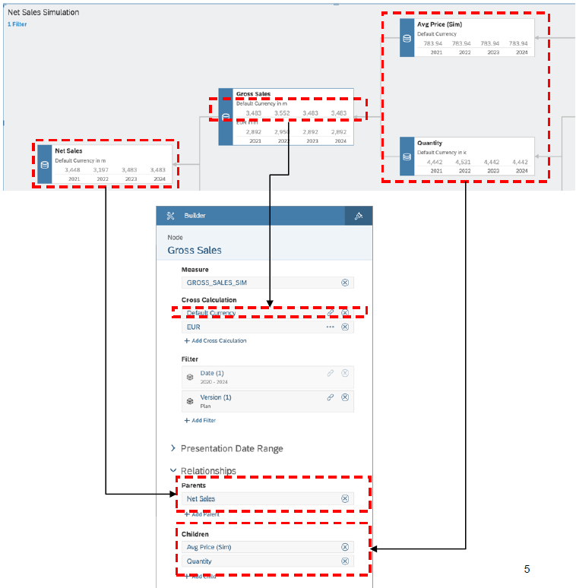
VDT
▪ For each node in the tree, the following parameters
can be configured:
− Measure: KPI to be shown (member of the
account dimension)
− Cross Calculation: Additional measures based
on the base KPI (e.g. different currencies)
− Filter: Scope definition for the KPI
− Presentation Date: Time horizon displayed in
the node
− Relationships: Parent and child nodes in the
tree
www.anubhavtrainings.com

Slide 21
Demo Scenario

Slide 22
End of Day 6

Slide 23

Questions

Slide 24

Anurag Bajaj
anurag.bajaj02@gmail.com

